Slide 1

E-Book

Slide 2
Post Graduate
Department of Computer science and Technology

Slide 3

PLUSINFOSYS
PLUSINFOSYS is a software consultancy and outsourcing company providing software development services across the globe.
Founder :
Darshna Vekaria
Founded :
2013
IT Services and IT Consulting
Industries :
Specialities :
iPhone Apps Development, iPad Apps Development, App Start Up Consulting, Android Apps Development, Website Development

Slide 4
E-Book
Project Profile
Project Overview
Modules
Use Case Diagrams
Activity Diagrams
Data Dictionary
Screen Layouts
Conclusion

Slide 5
E-Book
Project Title : | E-Book
Company : | Plus Infosys
Project Guide : | Kinjal Bhatt
External Guide : | Dr Prashant P. Pittalia
Duration : | 4 Months.
Tools used: | SQL Server Management Studio, Visual Studio 2022
Front End:: | HTML, CSS, BOOTSTRAP, AJAX, C#
Back End: | SQL Server, C#, ASP.NET Core
Team Members : | Bhuva Krupali Halai Miti Joshi Riddhi

Slide 6
Project Overview
An ebook (short for electronic book) is a book publication made available in digital form, consisting of text, images, or both, readable on the flat-panel display of computers or other electronic devices.
Although sometimes defined as "an electronic version of a printed book",some e-books exist without a printed equivalent.
E-books can be read on dedicated e-reader devices, but also on any computer device that features a controllable viewing screen, including desktop computers, laptops, tablets and smartphones.

Slide 7
System Requirment
When a library management system will be implemented librarian and user will easily access library as searching and book transaction will be very faster.
The system is designed for a user friendly environment so that student and staff of library can perform the various tasks easily and in an effective way.

Slide 8
System Objective
Improvement in control and performance
The system is developed to cope up with the current issues and problems of library
The system can add user, validate user and is also bug free.
Save cost
After computerized system is implemented less human force will be required to maintain the library thus reducing the overall cost.
Save time
Librarian is able to search record by using few clicks of mouse and few search
keywords thus saving his valuable time

Slide 9
Modules
1. Admin
Can Login with valid credentials.
Searching Books.
See Books details.
Add Books detail.
Delete Books cards
Manage[Edit Information] Books details.
Manage his profile.

Slide 10
2. Users
Can register & login with valid credentials.
Search category wise Books.
See Books details.
Manage cart.
Place & Manage Orders.
Manage his profile.
Able to create new password.

Slide 11
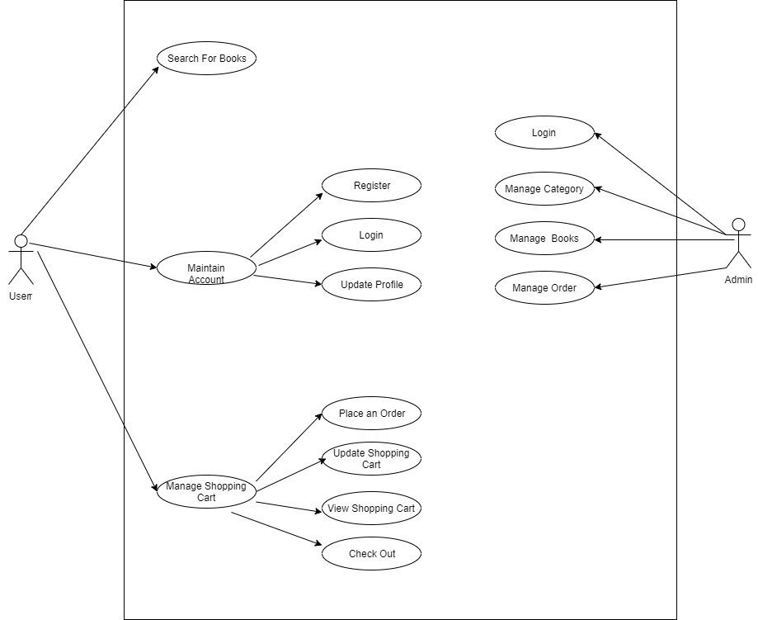
Use Case Diagram

Slide 12
Activity Diagram

Slide 13
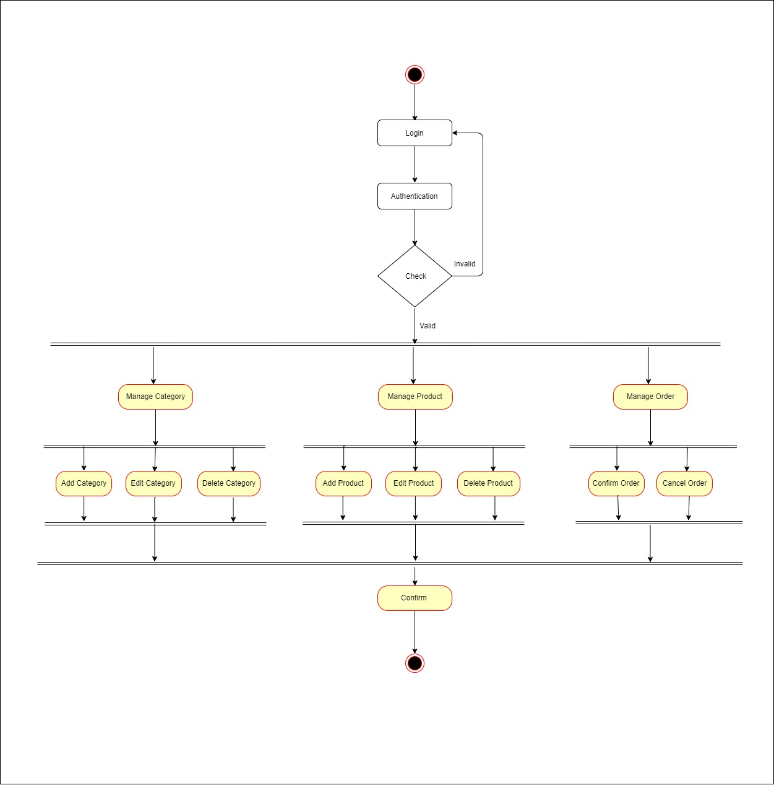
Admin

Slide 14
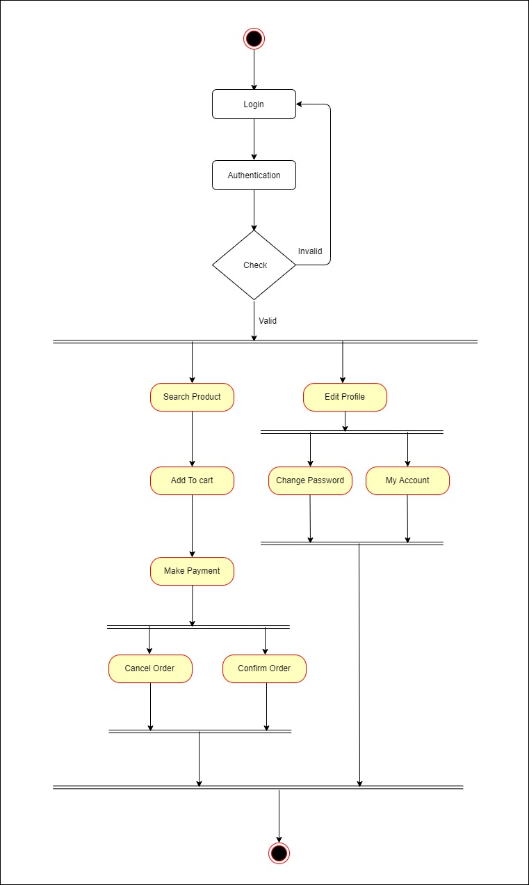
User

Slide 15
Activity Design

Slide 16
User
Admin
Primary Key:- UserId
Field Name | DataType | Constraints
Admin_Id | Int | NotNull
Name | Nvarchar(20) | Null
Address | Nvarchar(max) | Null
City | Nvarchar(20) | Null
Email | Nvarchar(max) | Null
Pincode | Nvarchar(10) | Null
State | Nvarchar(20) | Null
PhoneNumber | Nvarchar(15) | Null
Password | Nvarchar(18) | NotNull

Slide 17
User
Primary Key:- UserId
Field Name | DataType | Constraints
UserId | Int | NotNull
Name | Nvarchar(20) | Null
Address | Nvarchar(max) | Null
City | Nvarchar(20) | Null
Email | Nvarchar(max) | Null
Pincode | Nvarchar(10) | Null
State | Nvarchar(20) | Null
PhoneNumber | Nvarchar(15) | Null
Password | Nvarchar(18) | NotNull

Slide 18
Categories
Primary Key :- CategoryId
Field Name | DataType | Constraints
CategoryId | Int | NotNull
Name | Nvarchar(20) | NotNull
CreatedDateTime | Datetime | NotNull
Products
Primary Key :- Product Id
Foreign Key :- CategoryId
Field Name | Data Type | Constraints
ProductId | Int | NotNull
Name | Nvarchar(20) | NotNull
Description | Nvarchar(200) | NotNull
Price | Float | NotNull
Image | Nvarchar(Max) | NotNull
CategoryId | Int | NotNull

Slide 19
Carts
Primary Key: - CartId
Foreign Key: - ProductId , UserId
Field Name | DataType | Constraints
CartId | Int | NotNull
ProductId | Int | NotNull
Count | Int | NotNull
UserId | Int | NotNull

Slide 20
Order Table
Primary Key:- OrderId
FeildName | DataType | Constraints
OrderId | Int | NotNull
UserId | Int | NotNull
DateOfOrder | DateTime | NotNull
DateOfShipping | DateTime | NotNull
Amount | Decimal | NotNull
OrderStatus | Nvarchar | Null
PaymentStatus | Nvarchar(50) | Null
TrackingNumber | Nvarchar(10) | Null
Carrier | Nvarchar(50) | Null
SessionId | Nvarchar(10) | Null
PaymentIntent | Nvarchar(5) | Null
DateOfPayment | DateTime | NotNull
DueDate | DateTime | NotNull
Name | Nvarchar(20) | NotNull
Phone | Nvarchar(15) | NotNull
Address | Nvarchar(50) | NotNull
City | Nvarchar(20) | NotNull
State | Nvarchar(20) | NOtNull
PostalCode | Nvarchar(10) | NotNull

Slide 21
Order Details
PrimaryKey:- Id
ForeignKey:- OrderId,ProductId
Field Name | DataType | Constraints
Id | Int | NotNull
OrderId | Int | NotNUll
ProductId | Int | NotNull
Price | Decimal | NotNull
Count | Int | NotNull

Slide 22
Screen Layouts

Slide 23
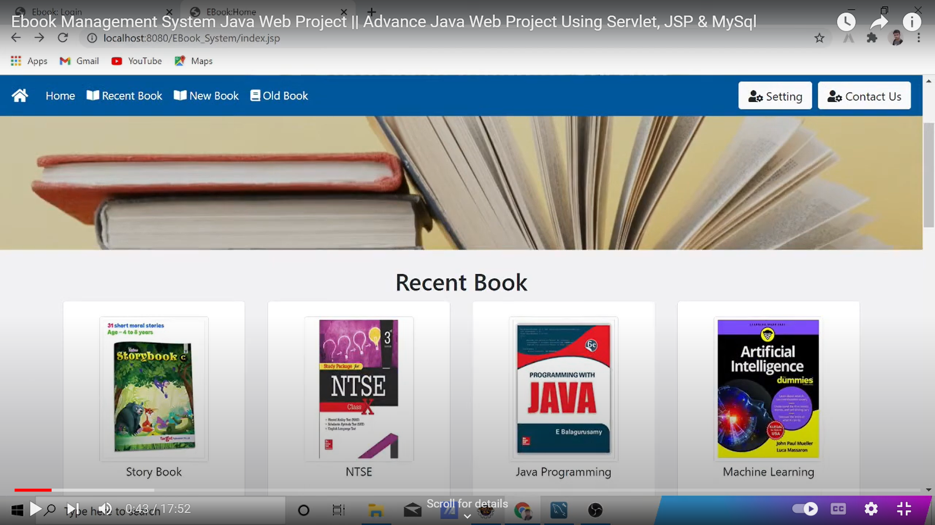
Home Page

Slide 24
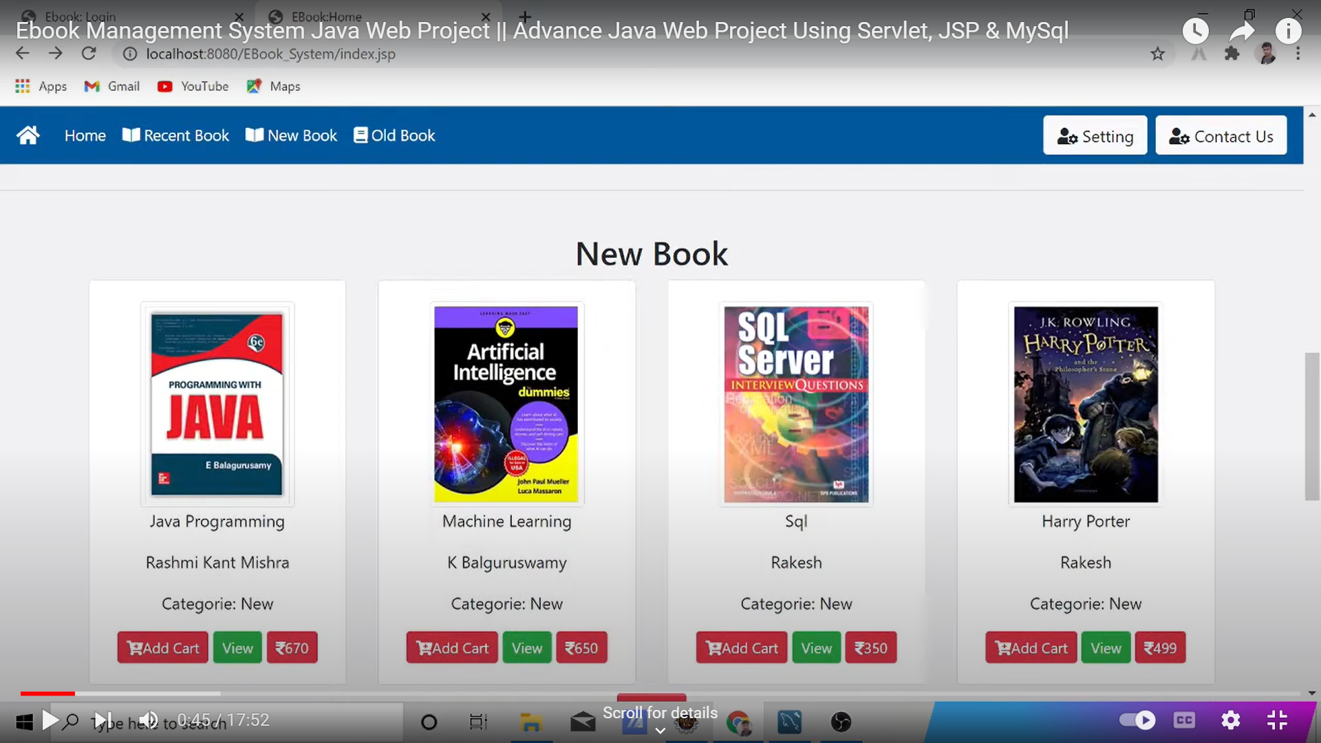
Home Page

Slide 25
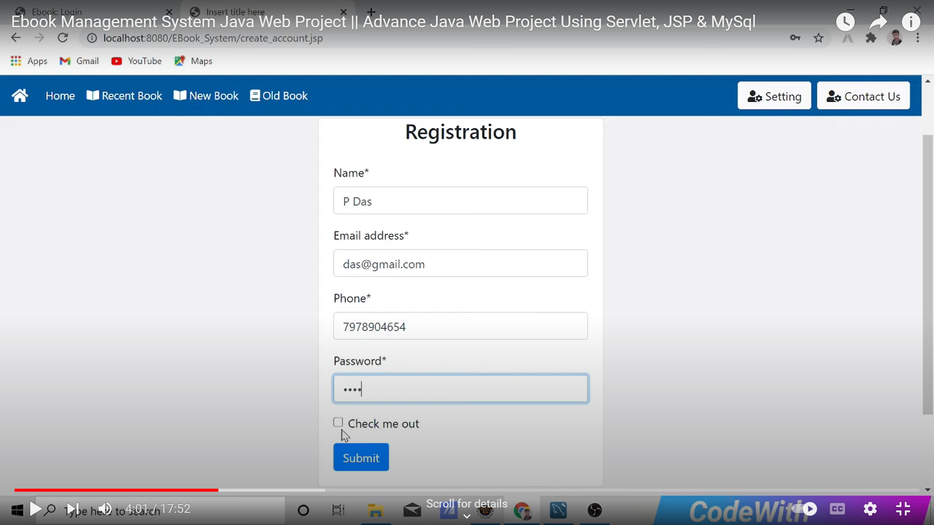
Registration

Slide 26
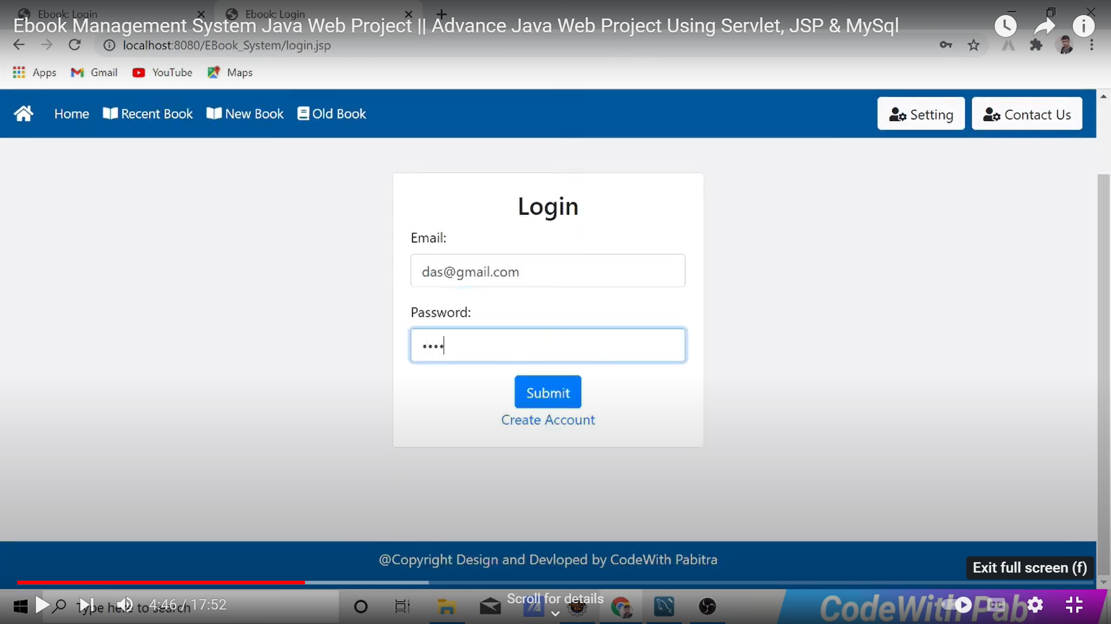
Login Page

Slide 27
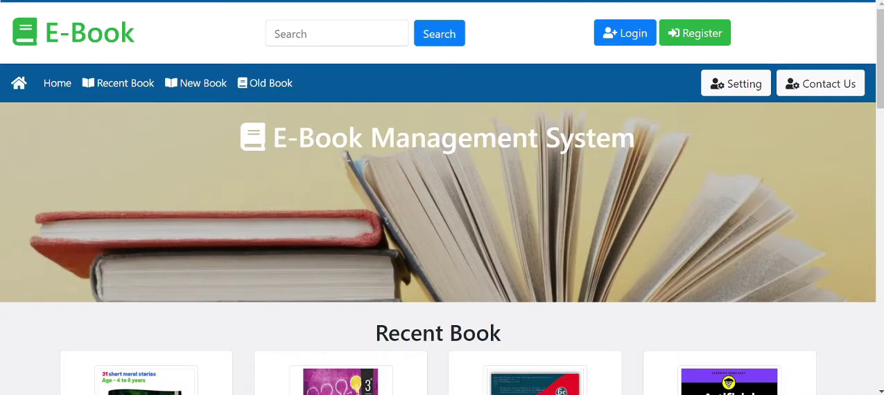
Home Page

Slide 28
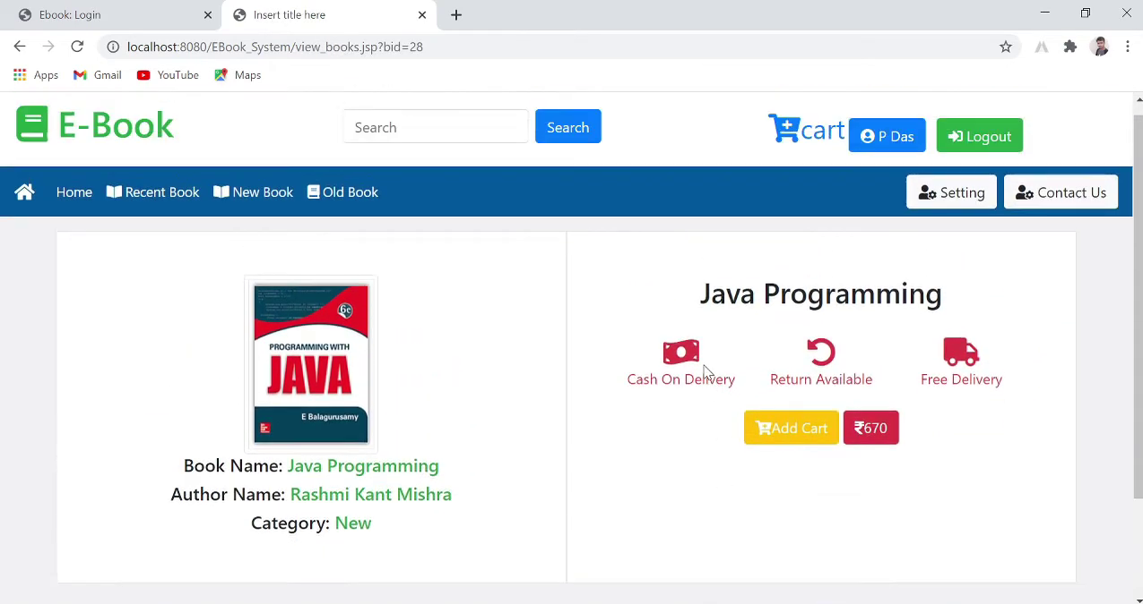
View Book

Slide 29
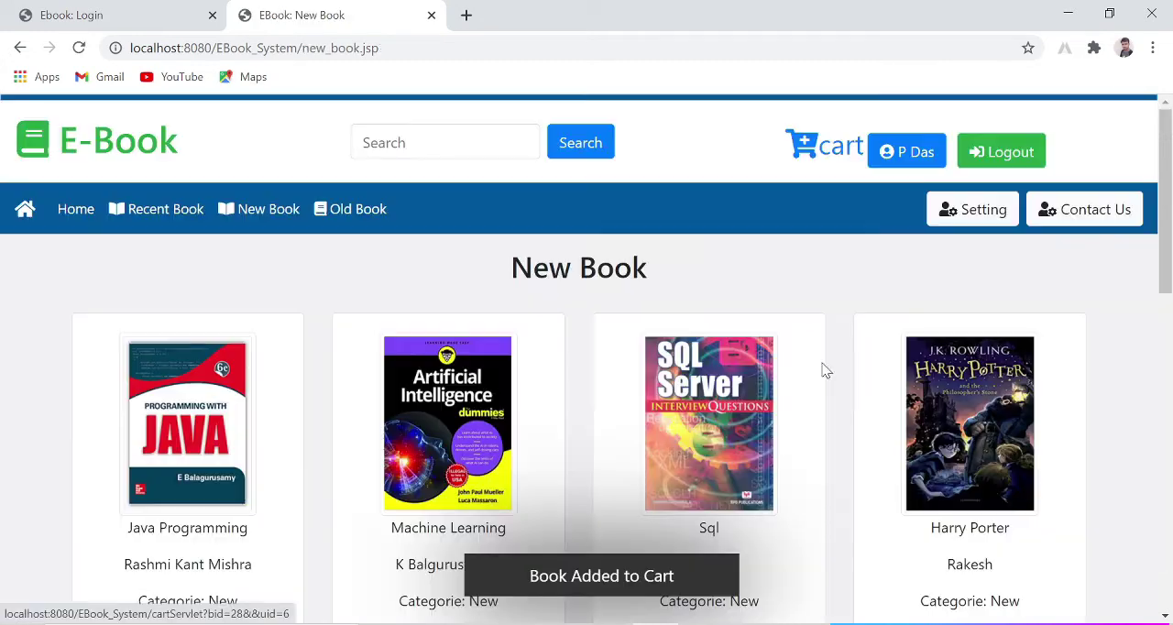
Add to Cart

Slide 30
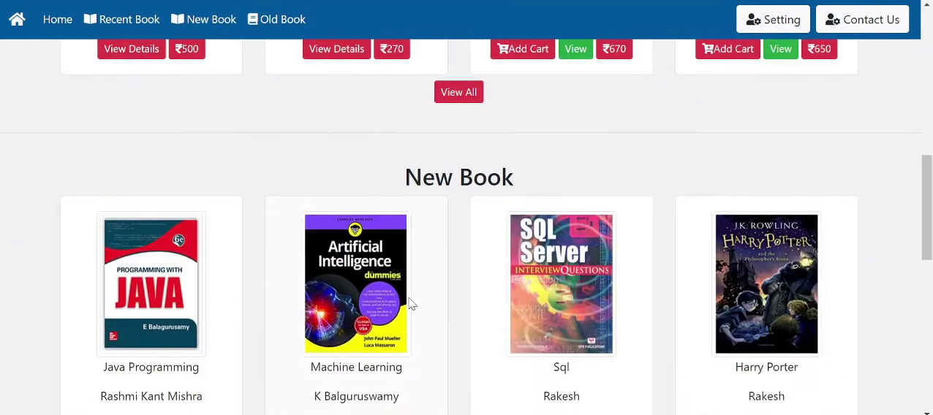
Add to Cart

Slide 31
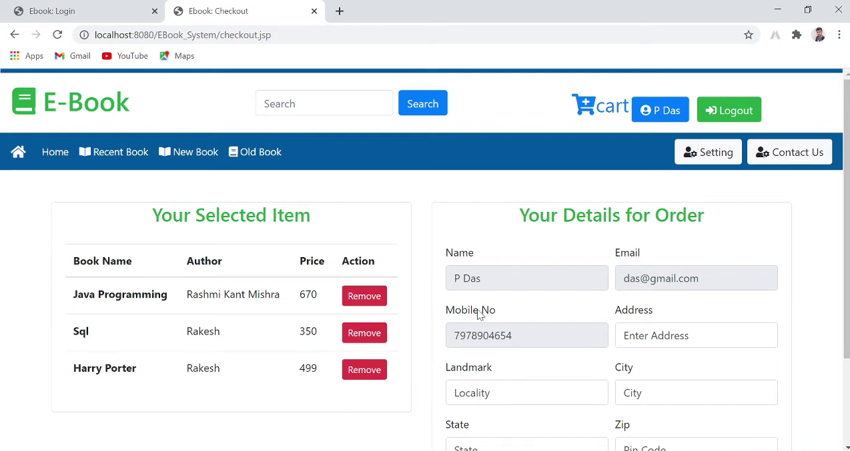
Order Details

Slide 32
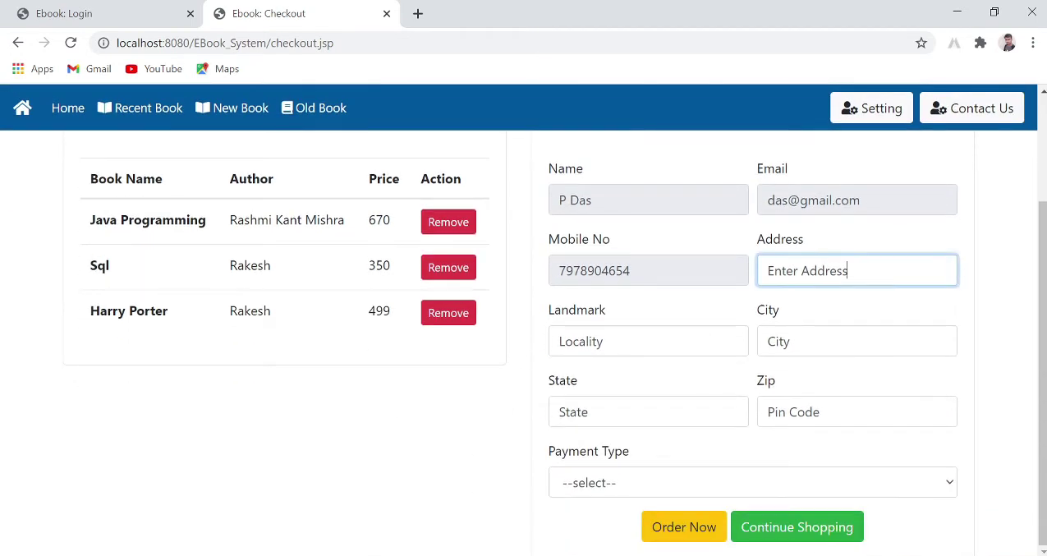
Order Details

Slide 33
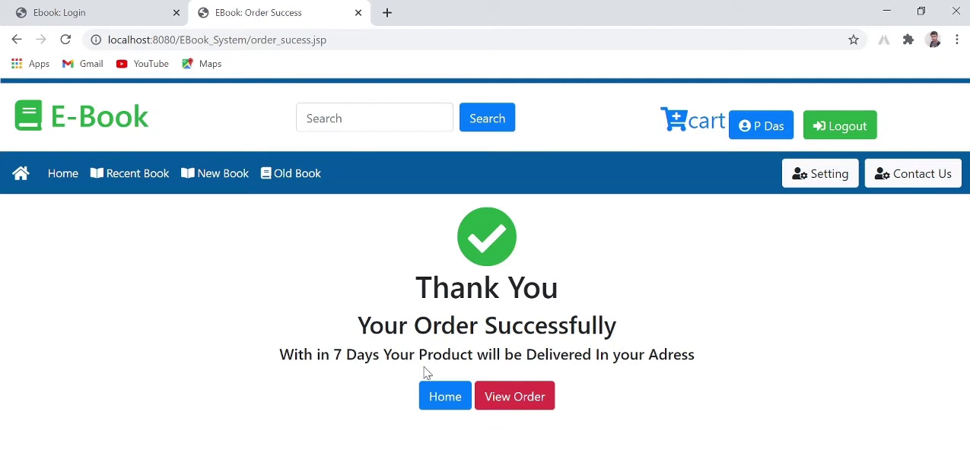
Order Successfully

Slide 34
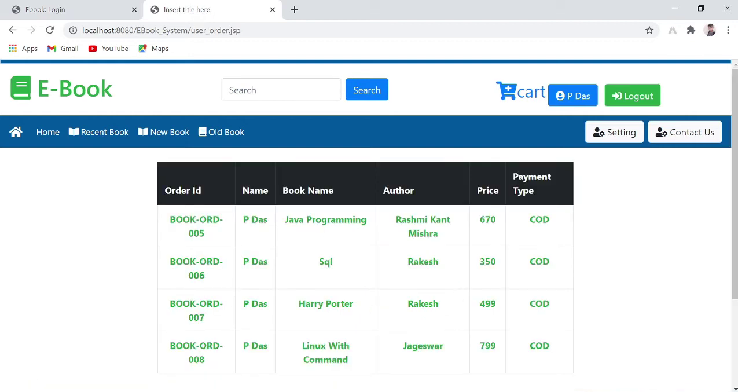
View Order

Slide 35
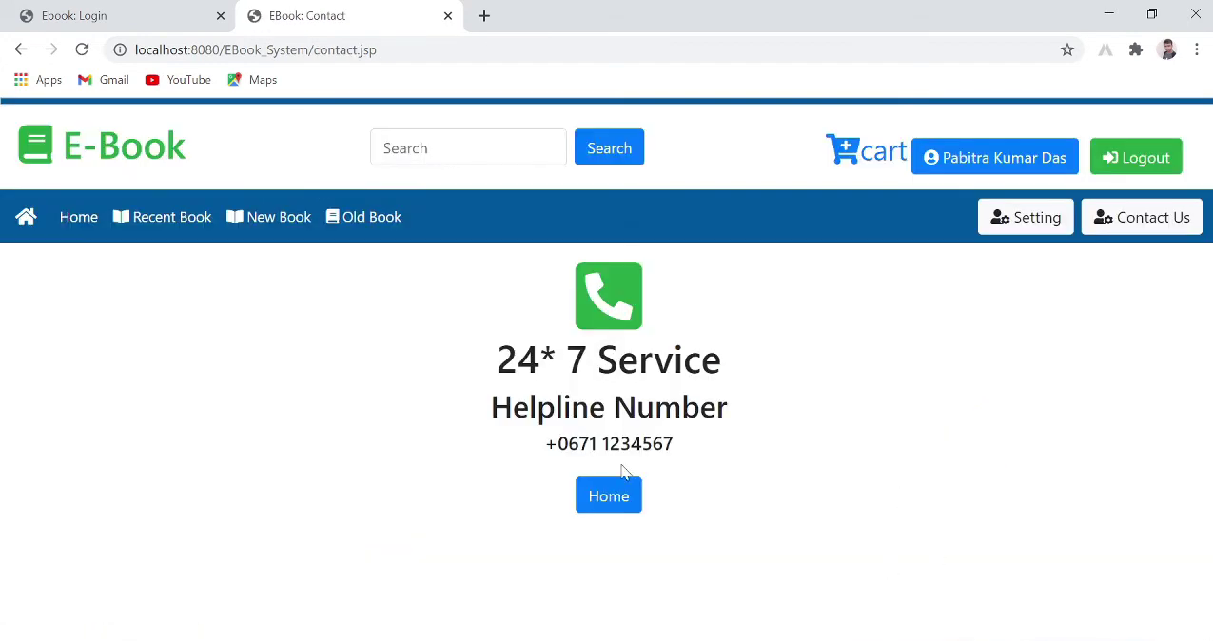
Contact Us

Slide 36
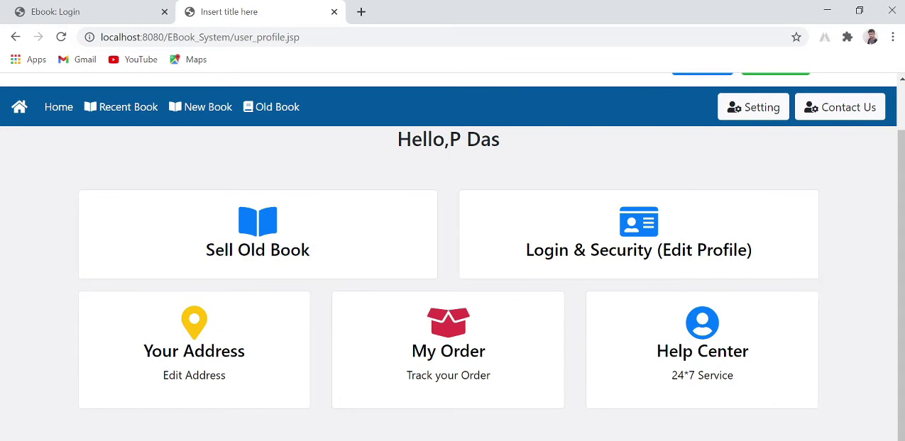
Setting

Slide 37
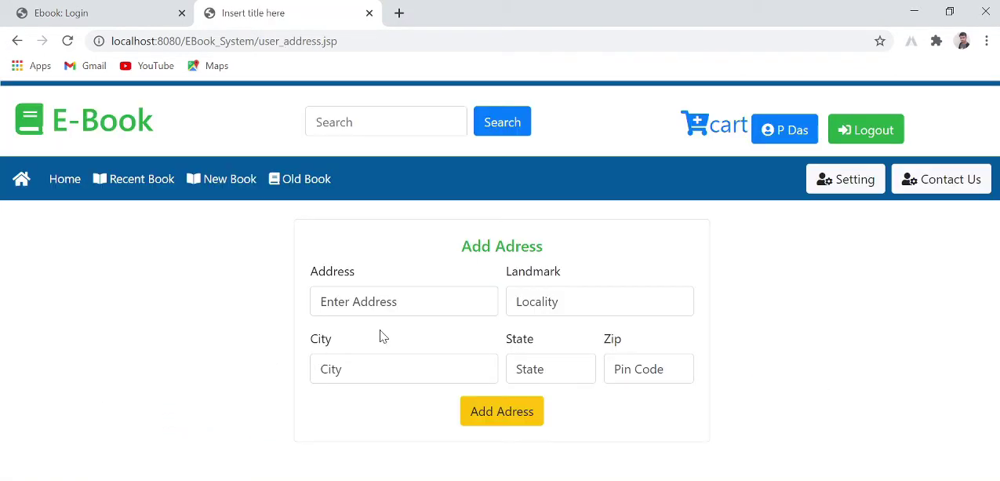
Add Address

Slide 38
Sell Book

Slide 39
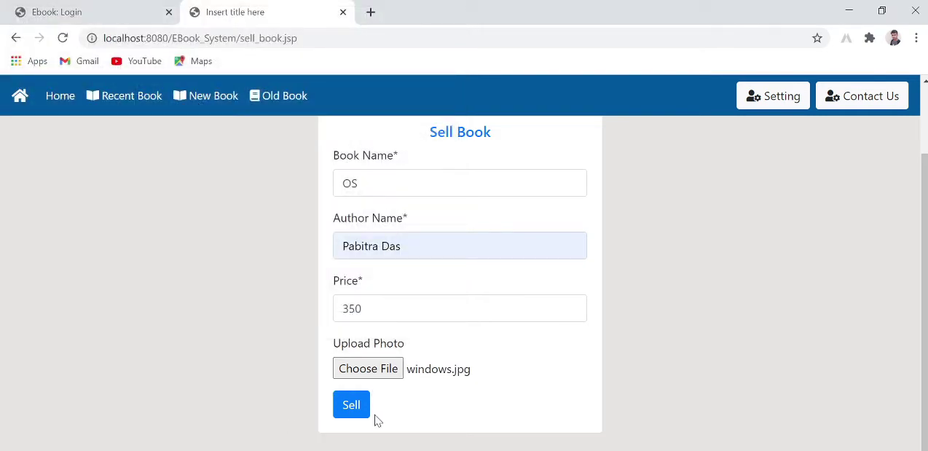
Sell Old Book

Slide 40
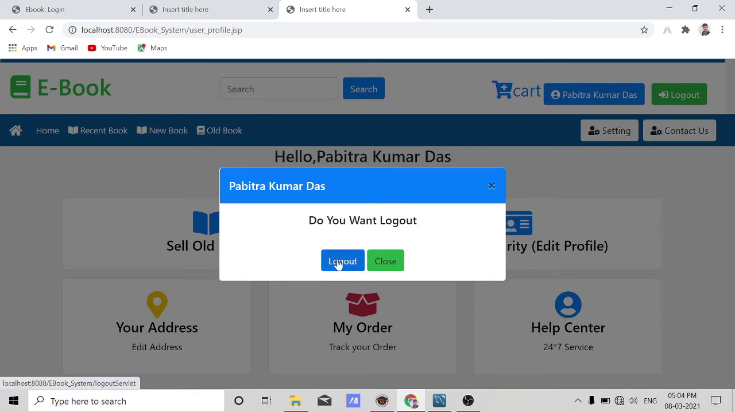
Logout

Slide 41
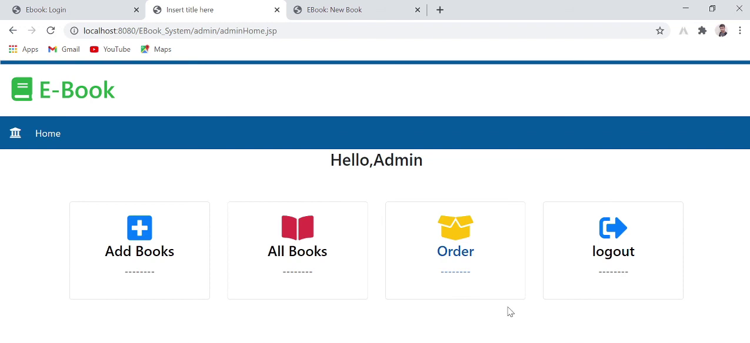
Admin Dashboard

Slide 42
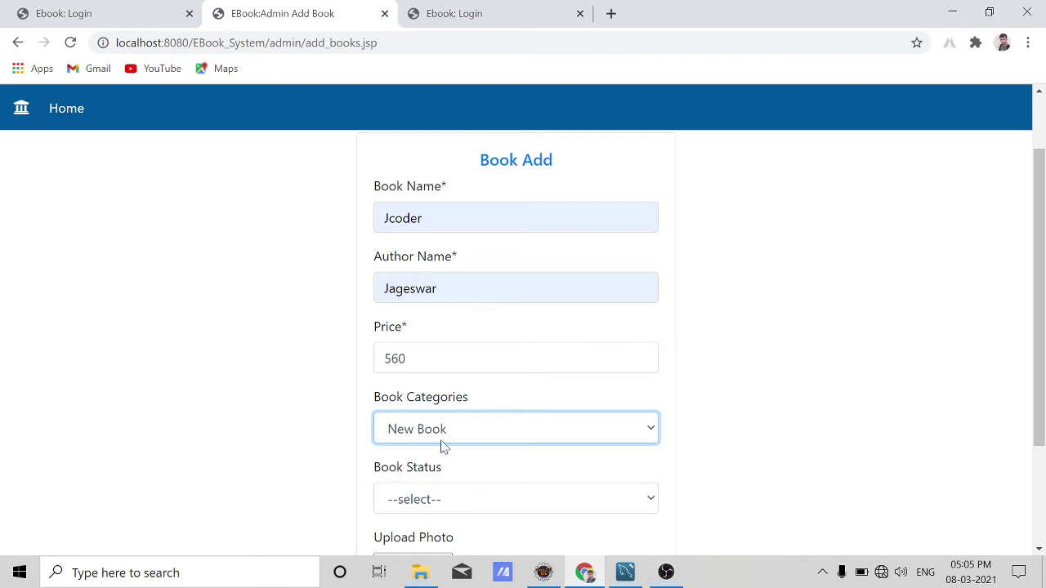
Add Book

Slide 43
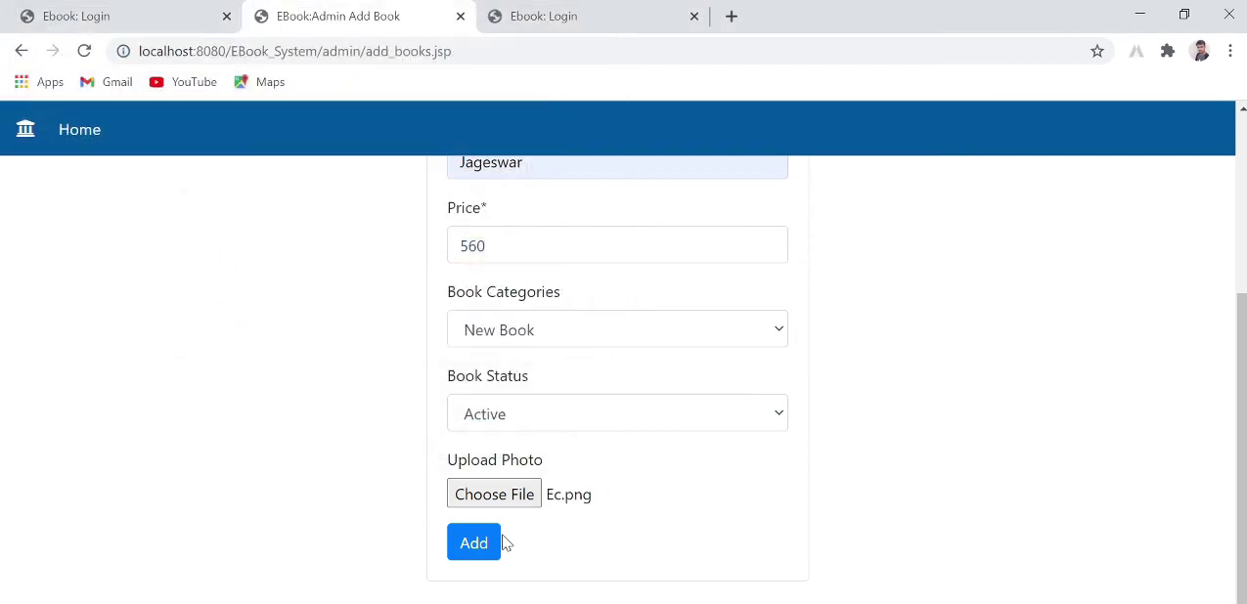
Add Book

Slide 44
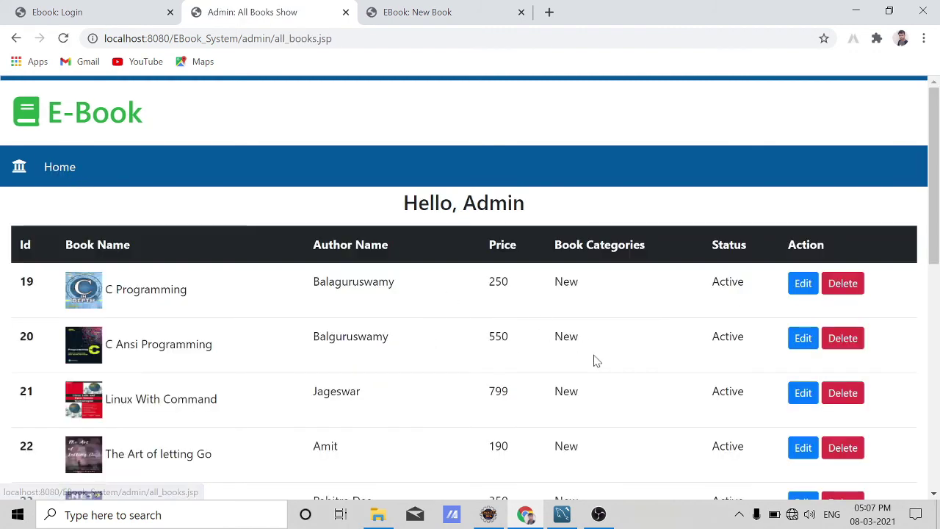
All Book

Slide 45


